Slide 1

CSUB CEI
Year End Report 2024

Slide 2

Mission
The Center for Entrepreneurship & Innovation supports CSUB’s entrepreneurship and innovation ecosystem in collaboration with other entities.
This includes:
The CSUB venture accelerator program
The Central California Emerging Technology Program
Student club activities
Educational offerings for the campus community
1

Slide 3

Table of contents
Accelerator Format & Improvements
Accelerator Metrics Inception to Date (2022-2024)
Accelerator Metrics Improvements Q3-4 2024
Founders Club Update
Central California Emerging Technology Program (CCETP) Inception to Date (2022-2024)
  R&D Projects
  Aerospace Workforce Development
Budget
Next Steps
Announcements
3
4
5
6
7-14
15
16-17
18
2

Slide 4

Accelerator FORMAT
& Improvements
2 cohorts annually of 10-15 ventures each
3-hour sessions 1x/week for 10 weeks
Focus on ideation and early-stage ventures
  Emphasis on aerospace, energy, & agriculture technologies
Curriculum centered on well-defined pitch deck format & public speaking practice
  Outside eyes and tough love early on (KVG online office hours)
Culminates in specific ask during pitch session with local angels
  3 out of 7 spring cohort ventures garnered KVG interest
3

Slide 5

accelerator Metrics
Inception TO DATE
42 ventures
  8 rural (19%), 29 minority (69%)
$1.5m in equity investment (personal funds, F&F, angels)
$250k in debt funding
$6.5m in grant funding (non-EDA)
$4.1m in revenue generation
38 jobs created or retained
Based on venture self-report data
4

Slide 6
accelerator Metrics improvements Q3-4 ‘24
11 additional ventures (Cohort 6)
  1 rural (9%), 8 minority (73%)
$1.1m+ in additional equity investment (personal funds, F&F, angels)¹
$250k+ in debt financing²
$6.3m+ in additional grant funding (non-EDA)³
$2.6m in additional revenue generation⁴
22 additional jobs created or retained²
1 - $1m Premier Resource Management; $100k other ventures
2 – Due to improved reporting
3 - $6m Premier Resource Management; $300k other ventures
5
4 – $2m due to improved reporting; $600k due to post accelerator growth

Slide 7

Founders club update
$80k acquisition of MobileCarwashBako
1 additional venture sent to CSU-wide fall pitch event (5 total across three CSU-wide events since fall 2023)
  2 additional anticipated for additional CSU-wide event spring 2025
14 total “ongoing concern” ventures (4 of which (28%) have garnered KVG interest)
Second Annual Pitch Championship Event tentatively planned for 2025
6

Slide 8
CCETP METRICS inception TO DATE
200+ interested engineering students
12 R&D projects
  8 aerospace, 5 energy, 5 agriculture
  Pipeline of 40+ additional potential projects
15 paid internship & job applicants (2024)
  2 full-time placements (NAWCWD, AFRL)
  2 part-time placements (MASP, AFRL)
  3 internship placements (MASP, AFRL)
7

Slide 9

Aerospace R&D projects
Spartan Systems (Accelerator)
Inventory management software for aerospace aftermarket parts. Winner of CSUB 2023 Founders Club Pitch Championship ($5k). Winner of 3rd Place, Best Partnerships, 2024 Sunstone Capital CSU Startup Launch Competition ($1k). Won based on proposed cooperations to test the software with MASP tenants Stratolaunch, Interorbital Systems, and now-defunct Universal Hydrogen as well as the founder’s existing family business, Saif Industries.
8

Slide 10
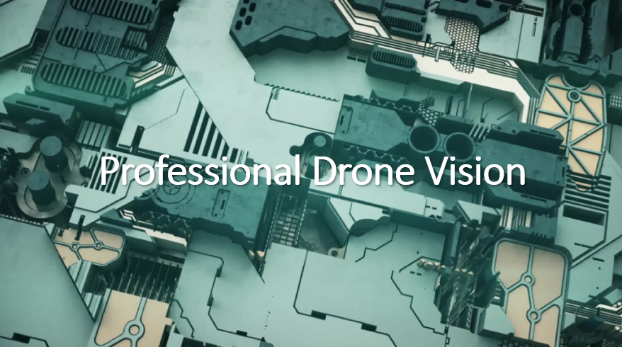
Aerospace R&D projects
Professional Drone Vision (R&D & Accelerator)
Student senior project (academic) & accelerator participant. Using structure for motion to enable drones to use RGB light to identify & characterize objects. Grew out of battlefield application for NAWCWD. Produced a paper presented at a CSU-wide conference on computer science and a paper presented at the 2023 Fifth International Conference on Transdisciplinary AI (TransAI). Code developed available on GitHub.
9

Slide 11


Aerospace R&D projects
NAWCWD Laser Heat Sink Research (R&D)
  Student paid & academic independent study project (6 students, 2 years, $25k). Using Ansys modeling software to identify novel turbulence patterns, geometries, materials, & coolants to dissipate heat in weapons-grade lasers. Grew out of battlefield application for NAWCWD.
Atomistic Modeling Consulting (Accelerator)
  Accelerator venture leveraging atomistic modeling expertise of faculty member Dr. Sungwook Hong to develop new metallic matrix with the conductivity of copper and the strength & weight properties of Haynes 188.
10

Slide 12



Aerospace R&D projects
NASA Blunt Shaped Body Research (R&D)
  Student paid & academic independent study project (1 student, 1 year, $1k). NASA T2U licensing project leveraging fluid dynamics expertise of faculty member Dr. Tat Acharya to improve upon the aerodynamic properties of a NASA spaceframe design patent.
Drone Flight Competition (Robotics Club)
  Student club project entry in CSULA competition focusing on autonomous flight; waypoint navigation; object detection, classification and localization; and air delivery of a package to a target.
3D Wing Assembly Competition (Robotics Club)
  Student club project in CSULA competition focused on design and flight testing of a 3D printed wing assembly.
Vortex Alternators (Accelerator)
  Accelerator project focused on a novel design to increase performance of alternators.
11

Slide 13
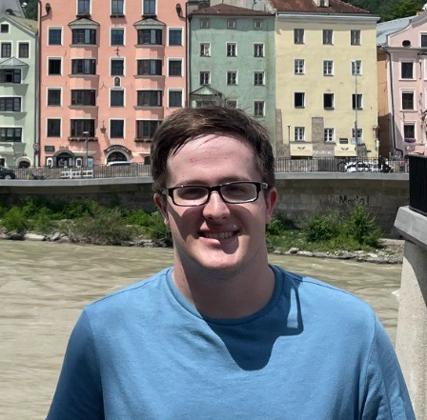
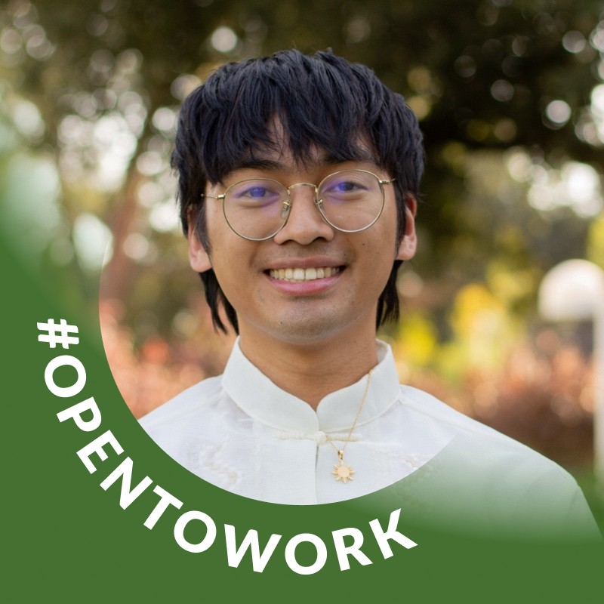
Aerospace workforce development
  Zach Swanson, NAWCWD Scientist & Engineer Development Program (SEDP)
  Full-Time: Hired upon graduation late summer 2024. Weapons testing.
  John Ramos, AFRL RQ/RC Program
  Part-Time: 2 days/week, $40k+ annual, starting fall 2024. CAD modeling work for the Air Force Research Lab Rocket Propulsion Division.
12

Slide 14
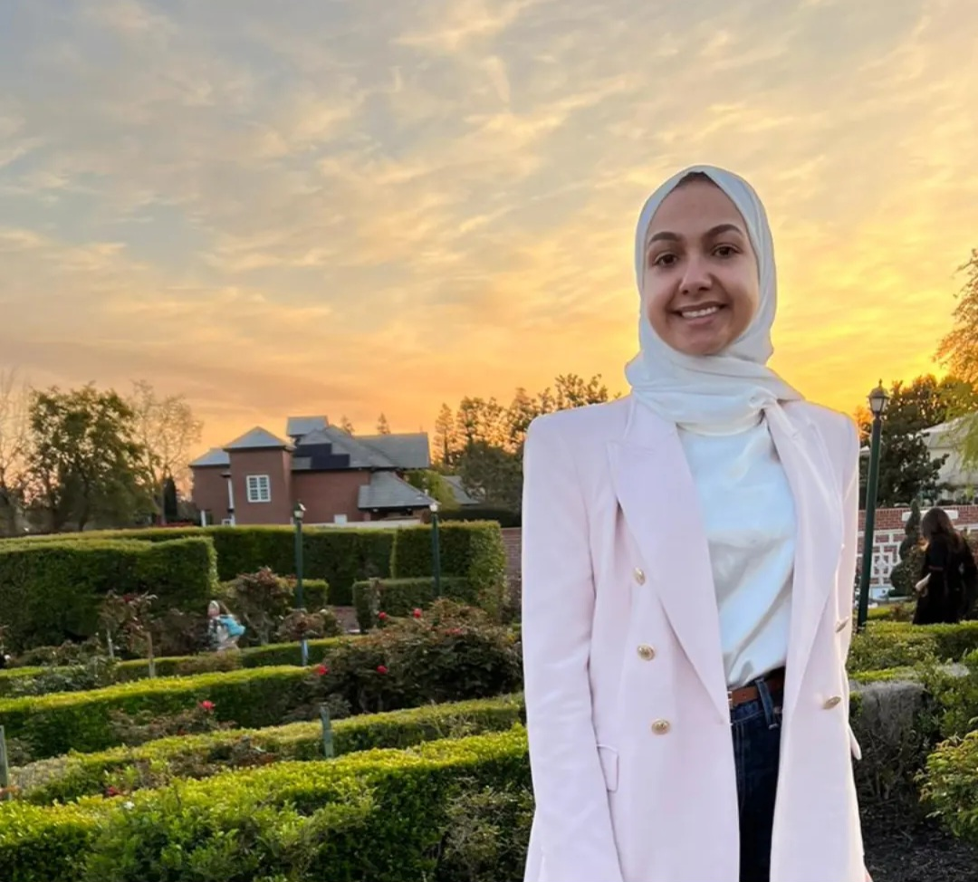
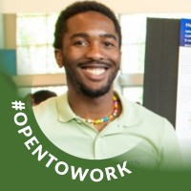
Aerospace workforce development
  Alia Al-Maitah, AFRL LLM AI research study | AFRL Technical Support
  Internship: $20/hour, 100 total hours, summer/fall 2024. Supporting research by AFRL Senior Engineer Rich Cohn on the use of AI to improve rocket propulsion chamber design.
  Full-Time: Hired as AFRL technical support staff member upon graduation.
  Gareth Ogunjobi, StellaSys
  Internship: 1 day/month plus on-campus work, $20/hour, 100 total hours, fall 2024. Supporting reconstruction of the starter box for an L-29 Delfin.
13

Slide 15
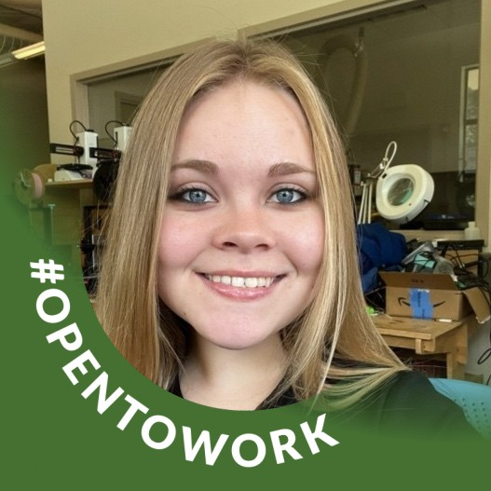
Aerospace workforce development
  Brhyona Thomas, Interorbital Systems
  Internship: 1 day/week, $20/hour, 100 total hours, summer 2024. Supporting cube sat development and other miscellaneous projects.
  Part-Time: Hired to continue 2 days/week after completion of internship.
14

Slide 16
Original 5-year operating budget
Funding Source | Focus | Budget
Community Donors | Venture accelerator & campus programming | $1.2 million
U.S. Economic Development Administration | Central California Emerging Technology Program | $709,000
15

Slide 17

NEXT STEPS
  Increase spending
    Personnel
    Accelerator & Founders Club
    Travel & Supplies
    Internship Program
  Determine specific spending allocations for Passport Program & Entrepreneurship Club
  Reallocate a portion of the Speaker Series/ Innovation Expo budget to Faculty Stipends in Collaboration with NSME & B3K
16

Slide 18
NEXT STEPS
  Expand recruitment of later-stage ventures into accelerator
  Expand support for Founders Club ongoing concerns
    Ongoing coaching focused on
      Increasing revenues
      Acquiring personnel & resources
      Pursuing additional funding
  Institutionalize CCETP activities together with NSME & B3K
  Expand pursuit of sustainable ongoing funding together with NSME, B3K, regional, and state partners
17

Slide 19

announcements
  Gandhi Fellowship in Social Entrepreneurship (Dr. Sarma, funded by Ravi and Naina Patel Foundation)
  Paper on entrepreneurial ecosystem collaboration being presented by Drs. Sarma, Amayah, & Woods at USASBE annual conference (Las Vegas, Feb. 13-15)
  Expansion of CEI-related grant writing activities by Aerospace Valley Futures (Board Members Dr. Woods, Alexia Svejda, Garrett Borunda, & David Allen)
  Tentative fractional sales management conversations initiated with select Founders Club members (Dr. Woods)
18

Slide 20
Questions?
Debi Cours, CEI Executive director
661-654-2023 office | dcours@csub.edu
Jeremy Woods, CEI Managing director
213-400-0829 cell | jwoods7@csub.edu
Peter Burley, CCETP Coordinator
661-382-7604 cell | pburley1@csub.edu

