Slide 1
Entrepreneurship Club
Bank of America Speaker Panel Series
Q1-Q2 2019
For more information please contact Dr. Jeremy Woods, jwoods7@csub.edu, 213-400-0829 (cell)

Slide 2
Contents
Logistics p. 3
Aerospace p. 4
Petroleum p. 5
Agriculture p. 6
Health Care p. 7

Slide 3
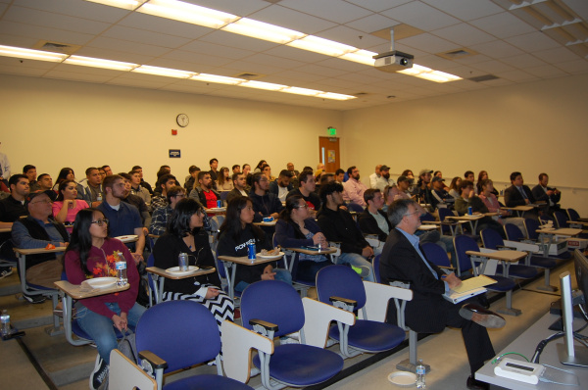
Logistics
Date
Friday, February 1, 2019
Attendance
80
Cost
$250
Venture Ideas Discussed
2
(New product placement
at Countryside, Target, and Dollar General; pitching student ventures to KVG)
Job Opportunity Exposure
Over 50 (Multiple internship and full-time positions
with Target and Dollar General; additional opportunities with other panelists)
Speakers
Raji Brar, Chief Operations Officer, Countryside Market & Restaurants
Frank Gonzalez, Sr. Operations Manger, Target Distribution Center
Otto Petgrave, Owner, OP Premium Star Logistics
Paul Porter, Human Resource Manager, Dollar General Distribution Center
Nathan Thompson, Inbound/Outbound Manager, Dollar General Distribution Center
Brittany Watkins, Operations Manager, Target Distribution Center

Slide 4
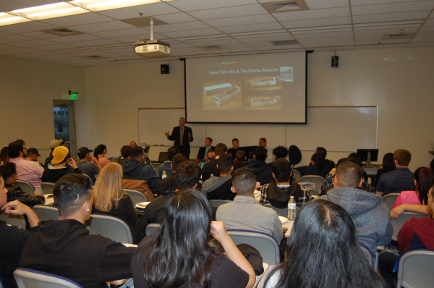
Aerospace
Date
Friday, March 1, 2019
Attendance
70
Cost
$350
Venture Ideas Discussed
2
(Recruiting services to
get Millennial engineers to relocate to Palmdale/Ridgecrest; networking in Mojave)
Job Opportunity Exposure
Over 100 (Multiple internship and full-time positions
with NASA, China Lake, and Northrop Grumman; additional opportunities in Mojave)
Speakers
Drew Christensen, Technical Operations Sr. Manager, Northrop Grumman
Derrick Hu, Deputy Director, Office of Small Business Programs, China Lake Naval Weapons Center
Cam Martin, former Chief of External Affairs, NASA Armstrong Flight Research Center
Todd Quelet, Site Manager, Stratolaunch

Slide 5
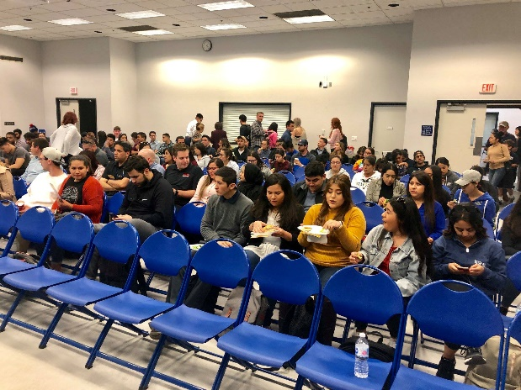
Petroleum
Date
Friday, March 29, 2019
Attendance
70
Cost
$350
Venture Ideas Discussed
7
(Big data, water recycling
extraction/productivity improvement, carbon sequestration, safety/regulatory issues)
Job Opportunity Exposure
Over 100 (Multiple internship and full-time positions
with CRC and Applus+ RTD; indirect opportunities with Chevron and independents)
Speakers
Burton Ellison, former Sr. Geologist, E&B Natural Resources
Tamer Ghobrial, Mechanical Integrity Engineering Lead, CRC
Jesse Holman, Owner, Enova
Derrick McCain, Vice President, North America, Applus+ RTD
Scott Sindelar, Technical Team Lead, CRC
Claude Vaughn, HR Manager, Chevron
John Yu, former Oil & Gas Engineer, CA Division of Oil, Gas, & Geothermal Resources

Slide 6
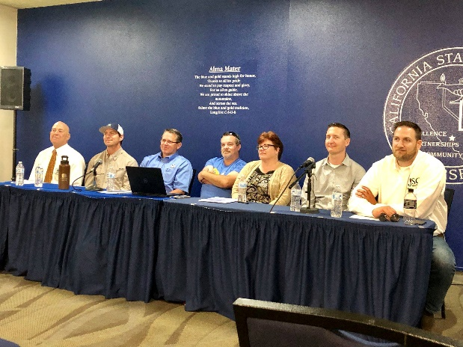
Agriculture
Date
Tuesday, April 23, 2019
Attendance
35
Cost
$350
Venture Ideas Discussed
6
(Big data, productivity
improvements, water conservation, safety/regulatory issues, sustainability)
Job Opportunity Exposure
Over 50 (Multiple internship and full-time positions
with Wonderful and Grimmway; additional positions with other panelists)
Speakers
Ian Joachim, Director of Financial Planning & Analysis, Wonderful Orchards
Ben Laverty III, President/CEO, California Safety Training Corp. and Board Member, Kern County Farm Bureau
Nicholas McGill, Ag Consultant & Owner, Kern Irrigation Scheduling
April Morris, Director of Employee Learning & Development, Grimmway Farms
Mike Pitter, Rental Fleet Manager P.E., Rain for Rent
Clay Watson, CEO, JSC Agricultural Supply

Slide 7
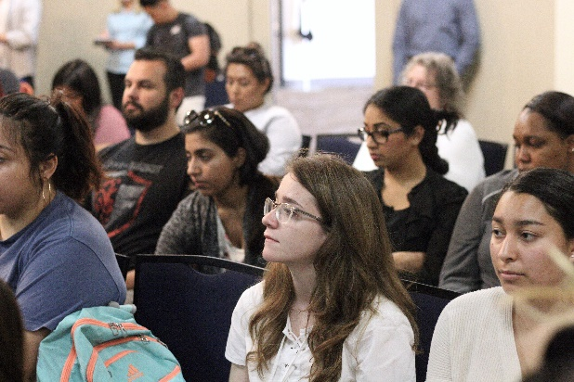
Health Care
Date
Thursday, May 2, 2019
Attendance
75
Cost
$350
Venture Ideas Discussed
13
(app development, healthy
behavior encouragement, infrastructure outsourcing, and big data, among others)
Job Opportunity Exposure
Over 50 (Numerous internship and full-time positions
with Kaiser Permanente, Dignity, & Omni; additional positions with other panelists)
Speakers
Tony Carbone, Chief Information Officer, Omni Family Health
Julie Juarez-Ceja, Community Liaison & Educator, Alzheimer’s Disease Association of Kern County
Ken Keller, President & CEO, Bakersfield Memorial Hospital (Dignity Health)
Neeraj Rama, Chief Investment Officer and Head of Strategic Collaborations & Innovations, Comprehensive Blood & Cancer Center
David Womack, Senior Vice President, Kaiser Permanente
Kevin Yebuah, Supervisor of Data Analytics & Reporting, Kern Health Systems

