Slide 1
CSUB Entrepreneurship & INNOVATION Programs

Slide 2
OVERVIEW of programs
Venture Accelerator
Aerospace Innovation Program
New Programs
Founders Club
Continuing Ed Expansion
Student Entrepreneurship Club Relaunch

Slide 3
2022-2023 accelerator Metrics
15 new business starts
$150k in seed stage investment (personal funds and f&f investors)
$300k in CalSeed grant funding
$600k in annualized revenue growth

Slide 4
2022-2023 accelerator Metrics
7.75 FTE jobs created
3 patent filings in process
3 copyright filings in process

Slide 5
Campus Aerospace recruiting
Nearly 200 interested computer science and electrical engineering students
Faculty expertise in:
Digital modeling
Machine Learning & AI
Microgrids & Renewable Energy
Fluid Dynamics

Slide 6
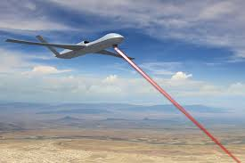
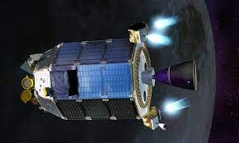
Aerospace r&D projects
Drone & Laser Technology (Navy)
Satellite Thruster Sustainable Fuel Technology (Air Force)
Hypersonic Vehicle Surfaces (NASA)
Nanoparticle Modeling for Composite Materials (CSUB Faculty)
And More!

Slide 7
2023-2024 Goals
Accelerator
$200k+ seed funding
$750k+ revenue growth
$400k+ grant funding
$100k+ loan funding
$100k+ angel capital funding
10 FTE jobs created
4+ patents/copyrights/trade secrets filed or contractually protected

Slide 8
2023-2024 Goals
Aerospace R&D
5+ projects
2+ FTE CSUB engineering student hires
Energy & Agriculture R&D
2+ projects
1+ FTE CSUB engineering student hires

Slide 9
2023-2024 Goals
Founders Club
Founders League top 9 “playoff” pitch competition during Global Entrepreneurship Week (Nov. 13-17, 2023)
Participation by top CSUB venture teams in CSU-wide Sunstone Capital pitch competition (Spring 2024)

Slide 10
2023-2024 Goals
Continuing Ed Program Expansion
10+ high-impact training modules
100+ participants
Student Entrepreneurship Club Relaunch
Bi-weekly meetings
Quarterly speaker panels
100+ active members

